Slide 1
Data Mining: Concepts and Techniques — Chapter 2 — Know Your Data

Slide 2
Data Objects
Data sets are made up of data objects.
A data object represents an entity.
Examples:
sales database: customers, store items, sales
medical database: patients, treatments
university database: students, professors, courses
Also called samples , examples, instances, data points, objects, tuples.
Data objects are described by attributes.
Database rows -> data objects; columns ->attributes.

Slide 3
Attributes
Attribute (or dimensions, features, variables): a data field, representing a characteristic or feature of a data object.
E.g., customer _ID, name, address
Types:
Nominal
Binary
Numeric: quantitative
Interval-scaled
Ratio-scaled

Slide 4
Attribute Types
Nominal: categories, states, or “names of things”
Hair_color = {auburn, black, blond, brown, grey, red, white}
marital status, occupation, ID numbers, zip codes
Binary
Nominal attribute with only 2 states (0 and 1)
Symmetric binary: both outcomes equally important
e.g., gender
Asymmetric binary: outcomes not equally important.
e.g., medical test (positive vs. negative)
Convention: assign 1 to most important outcome (e.g., HIV positive rarest one)
Ordinal
Values have a meaningful order (ranking) but magnitude between successive values is not known.
Size = {small, medium, large}, grades (A, A+), army rankings

Slide 5
Numeric Attribute Types
Quantity (integer or real-valued)
Interval
Measured on a scale of equal-sized units
Values have order
E.g., temperature in C˚or F˚, calendar dates
No true zero-point. its numeric so mean possible
Cant say 10 C is twice of 5C
Ratio
Inherent zero-point
We can speak of values as being an order of magnitude larger than the unit of measurement (10 K˚ is twice as high as 5 K˚).
e.g., temperature in Kelvin, length, counts, monetary quantities

Slide 6
Discrete vs. Continuous Attributes
Discrete Attribute
Has only a finite or countably infinite set of values
E.g., zip codes, profession, or the set of words in a collection of documents (Binary or 0 to 110 for age)
Sometimes, represented as integer variables
Note: Binary attributes are a special case of discrete attributes
Continuous Attribute
Has real numbers as attribute values
E.g., temperature, height, or weight
Practically, real values can only be measured and represented using a finite number of digits
Continuous attributes are typically represented as floating-point variables

Slide 7
Measuring the Central Tendency
Mean (algebraic measure) (sample vs. population):
Note: n is sample size and N is population size.
Weighted arithmetic mean: (for frequency or importance)
Trimmed mean: chopping extreme values say 2%
Median:
Middle value if odd, average of the middle two values
Mode
Value that occurs most frequently in the data
Unimodal, bimodal, trimodal

Slide 8
Measuring the Dispersion of Data
Quartiles, outliers and boxplots
Quartiles: Q₁ (25th percentile), Q₃ (75th percentile)
Inter-quartile range: IQR = Q₃ – Q₁
Outlier: usually, a value higher/lower than 1.5 x IQR above 3rd or below ist quartile. the whiskers terminate at the most extreme observations occurring within 1.5IQR of the quartiles. The remaining cases are plotted individually
Variance: (algebraic, scalable computation)
Standard deviation s (or σ) is the square root of variance s² ⁽or σ²⁾

Slide 9
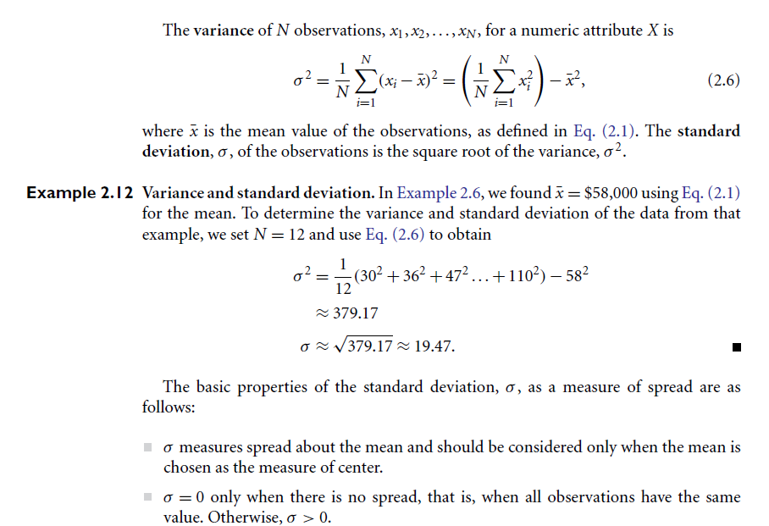

Slide 10
Similarity and Dissimilarity
Similarity
Numerical measure of how alike two data objects are
Value is higher when objects are more alike
Often falls in the range [0,1]
Dissimilarity (e.g., distance)
Numerical measure of how different two data objects are
Lower when objects are more alike
Minimum dissimilarity is often 0
Upper limit varies
Proximity refers to a similarity or dissimilarity

Slide 11
Data Matrix and Dissimilarity Matrix
Data matrix
Object by attribute structure(n x p)
n data points with p dimensions
Two modes
Dissimilarity matrix
Object by object structure(n x n)
n data points, but registers only the distance
A triangular matrix
Single mode

